Slide 1
Communication and Collaboration in Agile

Slide 2
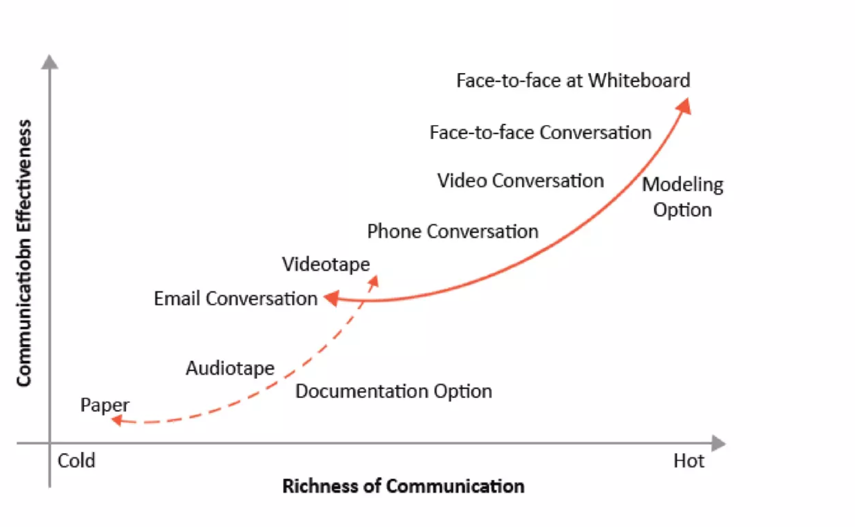
Project Communication
Every project manager quickly learns that the most valuable technique for project success is communication. However, there are many different types of communication and not all of them are as effective at communicating ideas.
Agile emphasizes that the most effective communication occurs face-to-face.

Slide 3
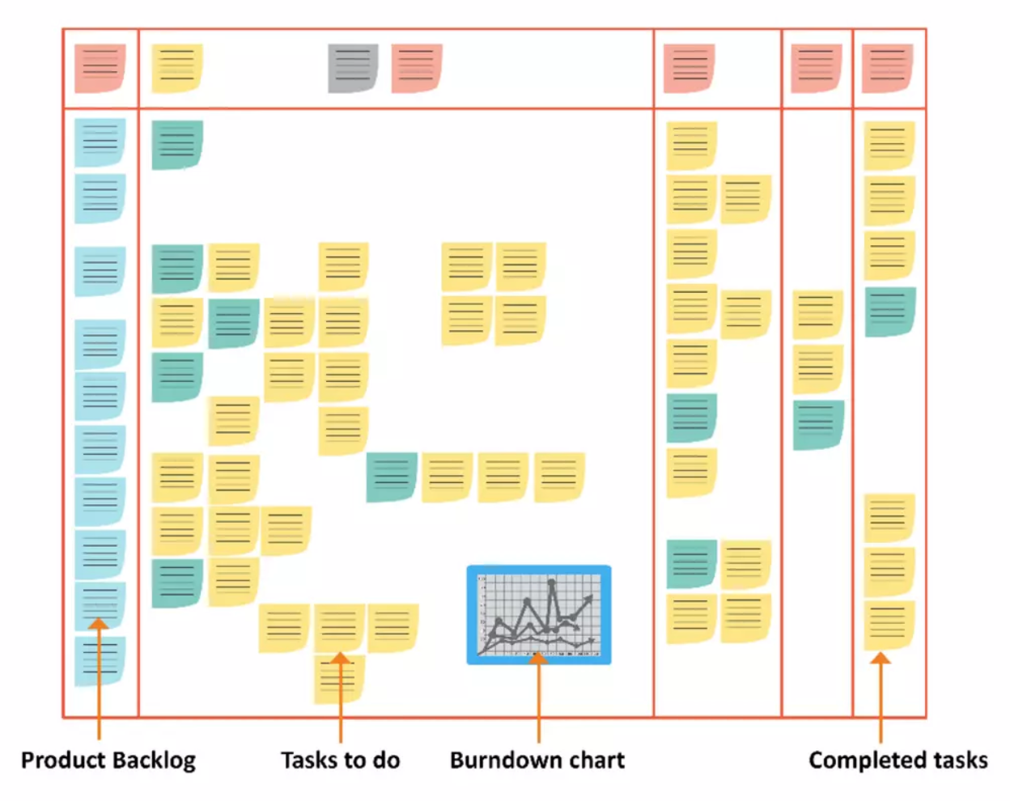
Task Board
The image represents an example of task board which is used as information radiator during project implementation.

Slide 4
Big Visible Charts
These are a part of the information radiator family and are an integral part of Extreme Programming (XP).
They provide information to the team and non-team audience, easily and without a lot of context.
These charts are casual, usually hand-drawn, big, and showcase important project information
It's working when:
people stop and read the charts;
team members don't complain about updating them; and
they reflect the reality of the project.

Slide 5
Effective information radiators
Effective information radiators should be:
Simple: Brief and concise.
Stark: Errors should not be masked, rather should be used to improve the work and performance.
Current: Information displayed should be the latest.
Transient: Once the problem has been rectified, it should be taken off from the chart.
Influential: Empowers the team to take decisions.
Highly visible: Easy to see and understand.
Minimal in number: Not so many that they drown out other information.

Slide 6
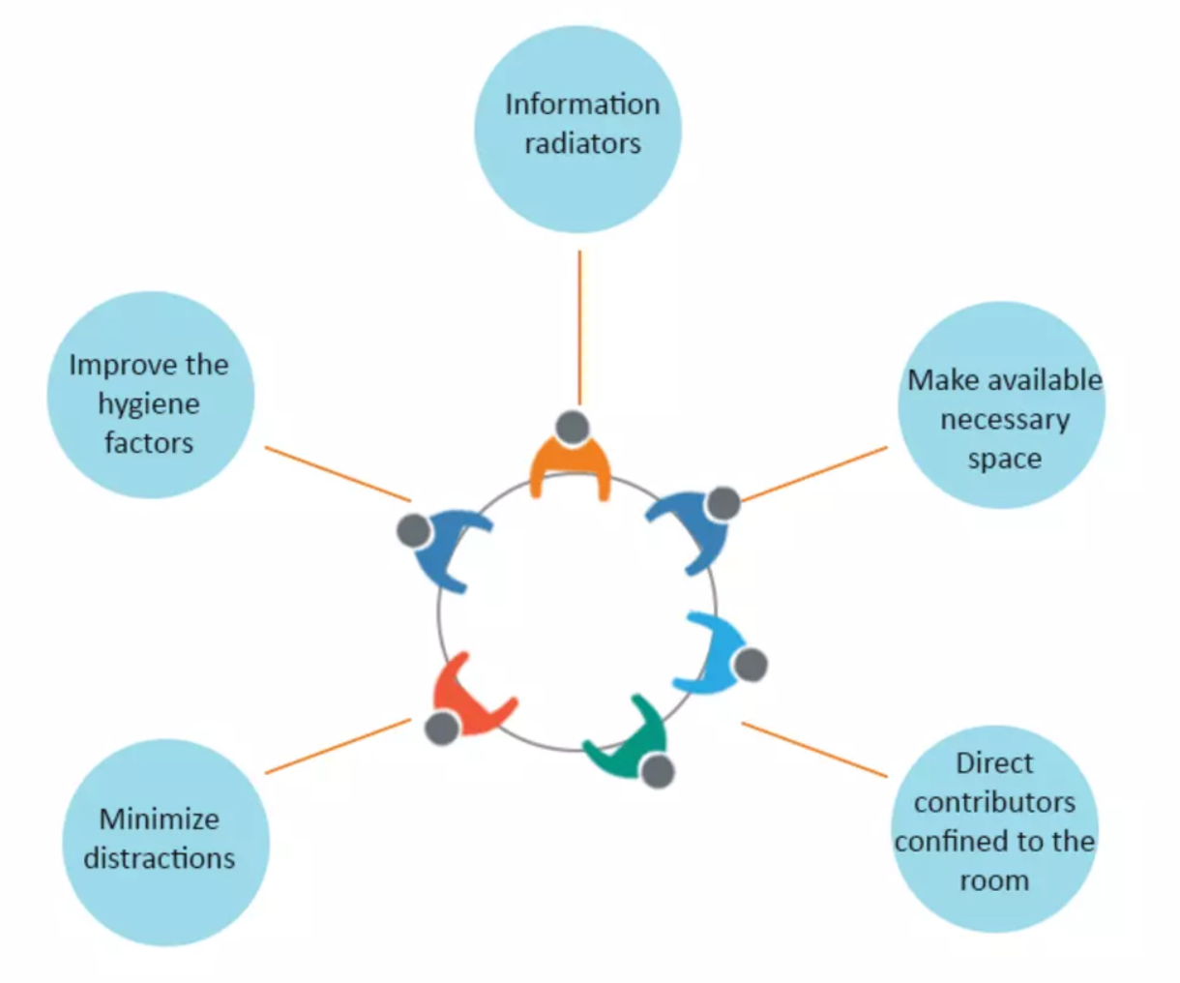
Team space
Team space is sometimes referred to as a “war room”. This involves getting the entire team together in one room and working on factors that foster communication as well as motivation leading to higher productivity.

Slide 7
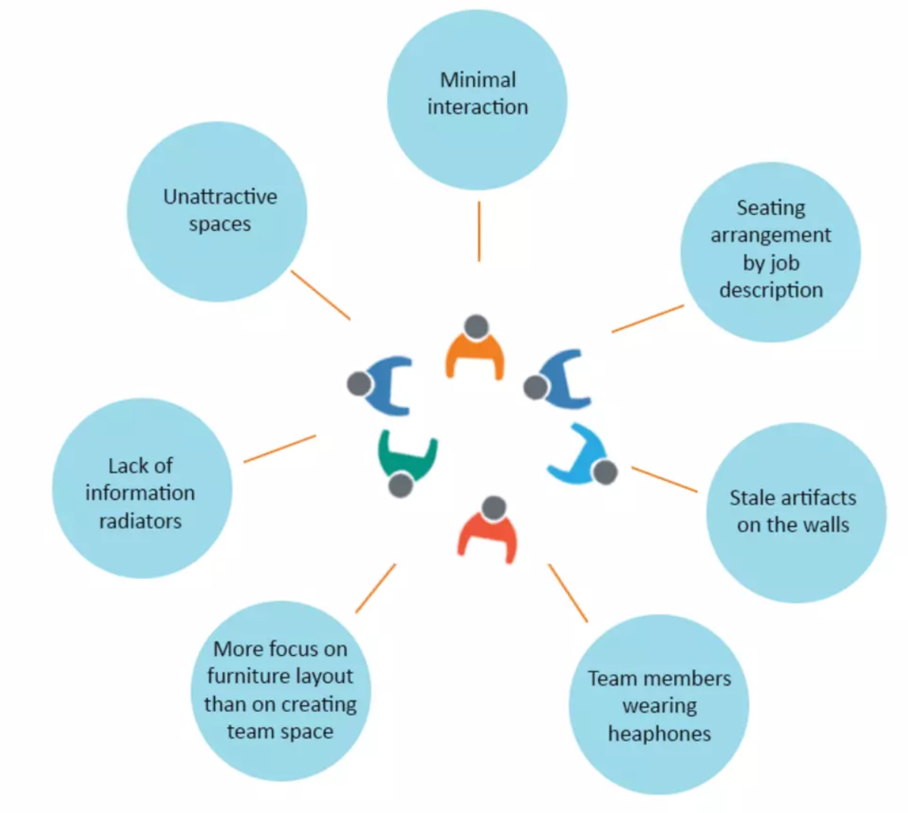
Signs of Bad Team
Bad team spaces can lead to chaotic and unproductive team output.

Slide 8
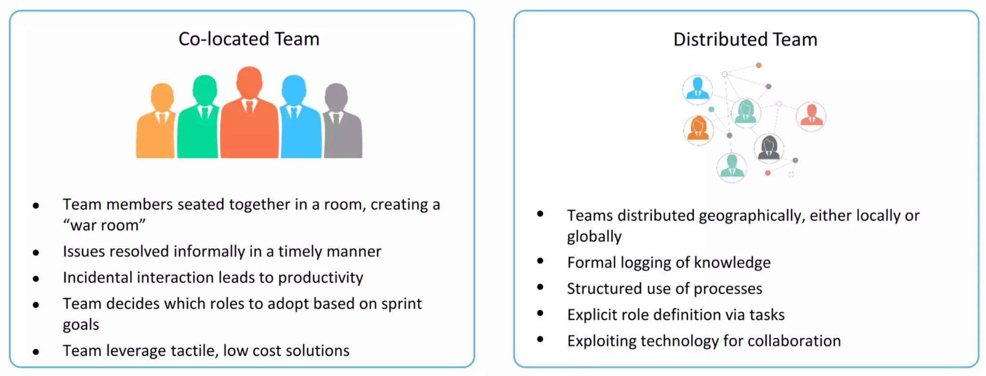
Co-located vs. Distributed Teams
Two types of teams can be identified.

Slide 9
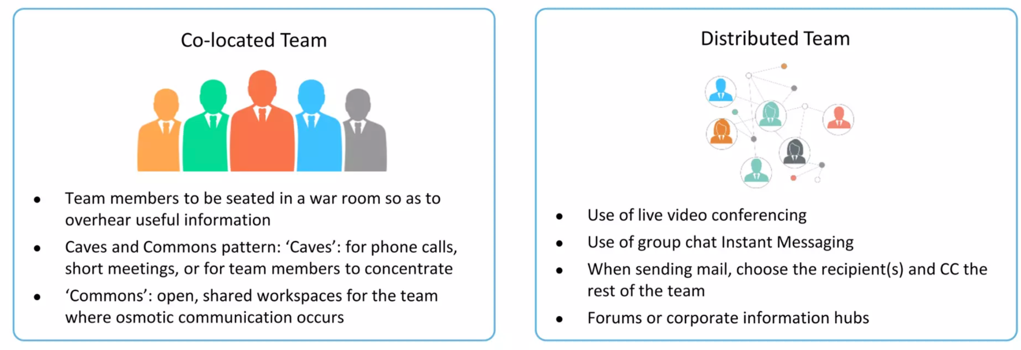
Osmotic communication
Osmotic communication occurs when information is overheard in the background of the team room and some of it is absorbed via osmosis.

Slide 10
Daily stand-up meetings
Daily stand-up meetings share progress on the sprint or iteration. Team members stand to keep the meeting focused and short. The stand-up is where each team member makes a commitment on what they will complete for the rest of the team to hear.
Scrum specifies that the meetings should be timeboxed to 15 minutes.
Only 'committed' team members are involved, with each participant answering 3 questions:
What did you do yesterday?
What will you do today?
What's in your way?

Slide 11
Agile Tooling
Multiple Open source tools are available are:
Agile specific project management tools (e.g. XPlanner)
Continuous integration build tools (e.g. CruiseControl)
Automated testing tools (e.g. JUnit, Fitnesse)
Agile software configuration management tools (e.g. Subversion)

Slide 12
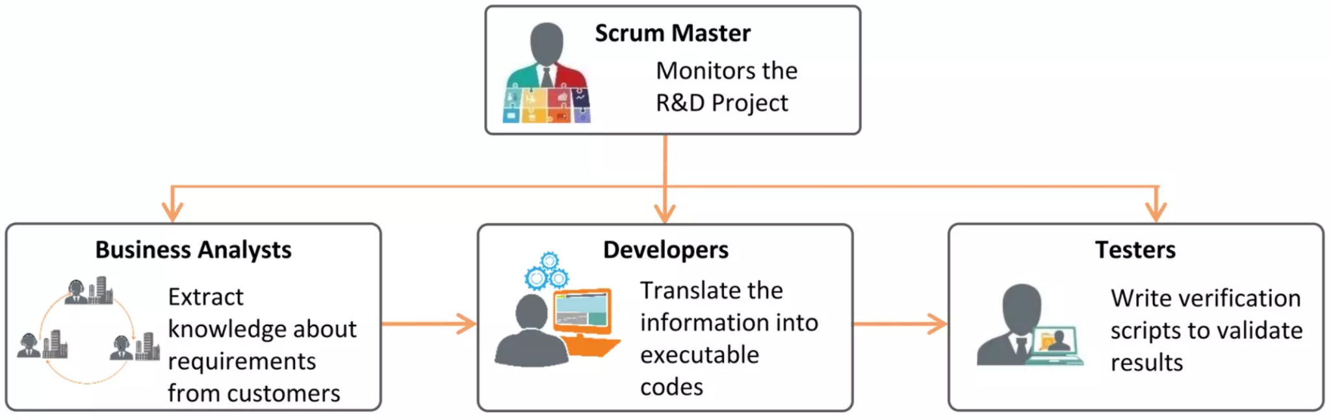
Communication Gap - Example
Natasha Lisovskii, the Scrum Master at Nutri Worldwide was monitoring an R&D project of developing a new Customer Relationship Management software package. Despite following Agile methodology, the project was behind schedule. The graphic below shows how the team members were working in silos and communicating through emails and physical documents.
List the changes that the Agile coach should implement to reduce the communication gap within the team.

Slide 13
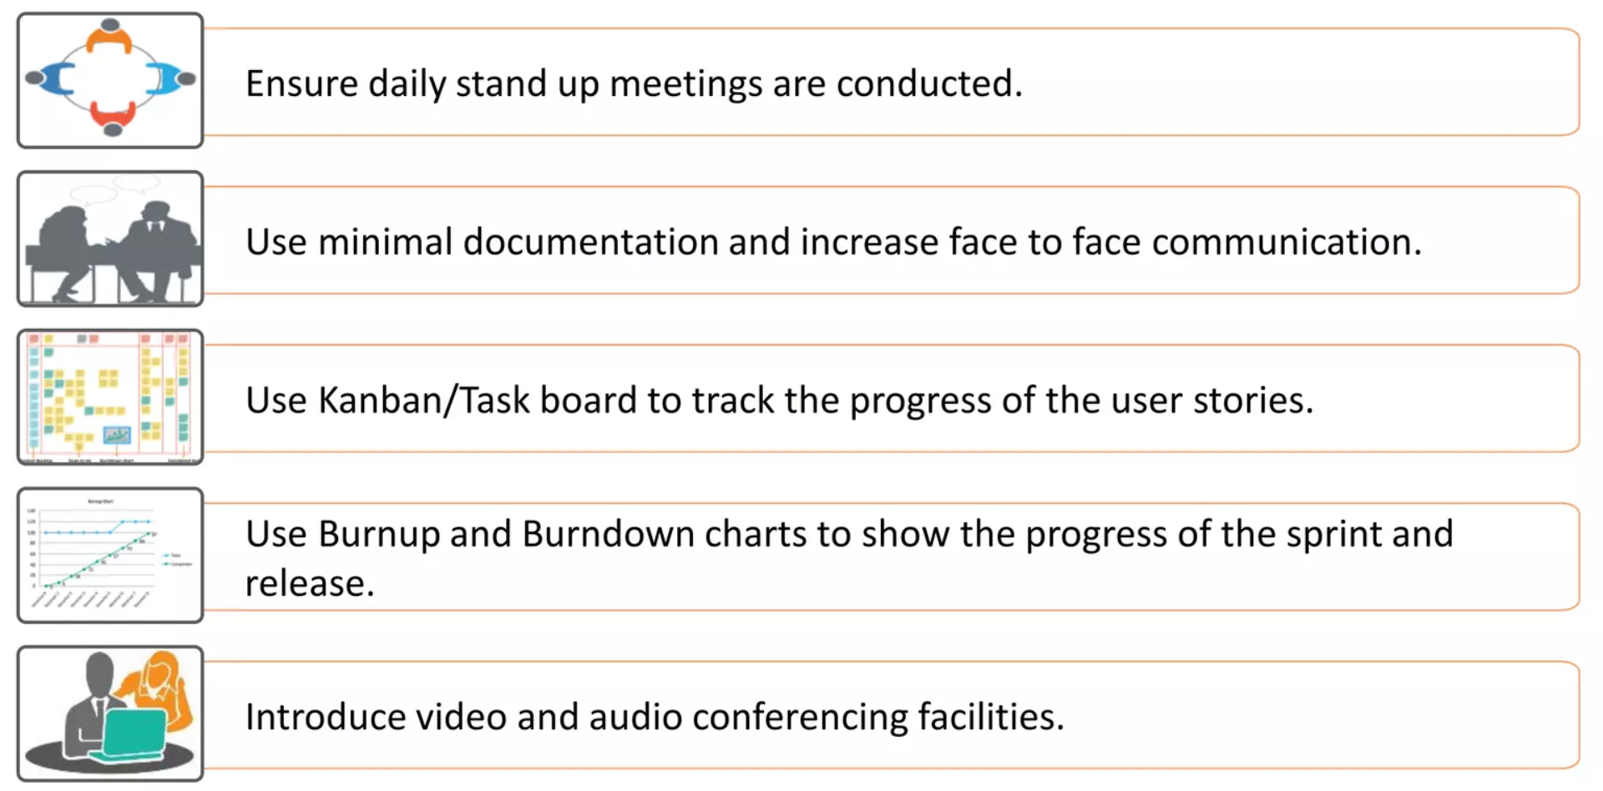
Communication Gap Example - Explanation
Listed are some of the recommended changes to help the team overcome the issues faced:

Slide 14
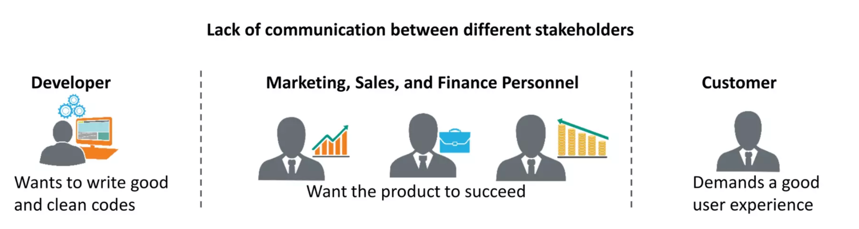
Real Life Example
Tony Orlando, the Executive Vice President of Sales and Marketing at Fairfax was asked about the primary reason behind project failures. The reason cited was the contradictory goals of different stakeholders working on the same project. The graphic below showcases the challenge faced.

Slide 15
Thank You

